Slide 1
Introduction to Quality Improvement Training for CHWs
Module 3
Prepared by Lyndee Knox and America Bracho

Slide 2
Learning Objectives: At the end of Module 3, you will be able to:
Describe people at your organization you might work with on QI
Use laser communication to share your QI ideas with your organization
Describe two resources available from the American Diabetes Association that you are interested in using

Slide 3
Root cause analysis
with the The 5 Whys
Brainstorming
Creating a 5-part QI goal
& “mini-plan”
Gathering stories and numbers (data)
about the quality issue
21

Slide 4
Root cause analysis
with the The 5 Whys
“Laser”
communication
skills
Brainstorming
Creating a 5-part QI goal
& “mini-plan”
Gathering stories and numbers (data)
about the quality issue
ADA resources
21

Slide 5
QI in Your Organization
Yourself
You may just need to make improvements on simple things in your own tasks and processes and decide to do this on your own.
Another CHW
You might work with a colleague in your organization – another CHW – or other people in your department.
A colleague, your supervisor, clinicians or staff
In a primary care practice, you might work with a doctor, a nurse, a clerk, the office manager. Anyone of your colleagues.
23

Slide 6
QI in Your Organization
QI team
If your organization has a formal QI director or team, sometimes you will work with them.
QI director
The QI director is the person in charge of making sure the practice is constantly looking at its data and working to improve it.
QI or Practice Facilitator
A practice facilitator is someone who is trained in QI and works with people from primary care practices to help them with QI
Don’t be shy. Introduce yourself to them and tell them you’d like to work with them on QI.
24

Slide 7
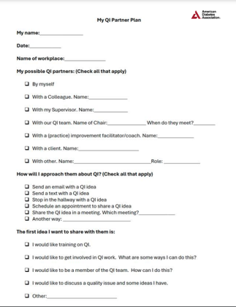
Exercise: Create Your Personal QI Partner Plan for Your Workplace
Who will you work with on QI?
How will you approach them?
What is the first QI idea you would like to share with them?

Slide 8
QI Projects in Busy Organizations
There are different ways of talking in different places.
We talk one way with our friends at dinner, and another way to our child’s teacher at school, and still another way with our boss at work.
25

Slide 9
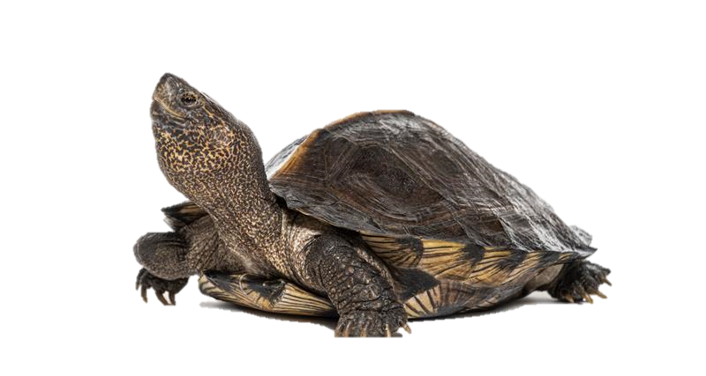
Talking to Family, Friends & Neighbors
Talking to family friends & neighbors is informal & can
wander
Conversations can wander and you can talk about a lot of different things. And they can be slow… take their time… like a turtle.
If you were to draw a conversation with a friend or a family member it might look like this.
26

Slide 10
Talking to Your Child’s Teacher or at Work is Focused & “Laser”
Communicating with your child’s teacher or your boss, however, looks different.
When you meet with your child’s teacher, you know the teacher doesn’t have a lot of time.
When you talk to the teacher, you use “Laser-Beam Communication.”
How would you describe a laser?
In Laser communication your conversation is short & focused
because you know the person doesn’t have much time.
27

Slide 11
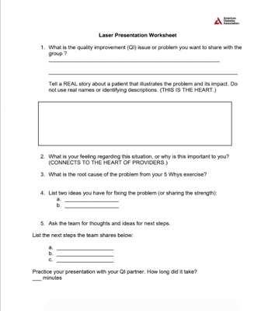
Worksheet for Making a “Laser” Presentation
Use this worksheet to help you create a “laser” presentation for your organization or the practice where you work.
Activity: Make a laser presentation to
present your personal QI project to the group

Slide 12
Ask the Magic Question: “What are the Next Steps?”
Asking people their ideas on next steps gets them to participate as your thinking partner.
Asking next steps helps you create a “to-do” list to keep your idea moving forward.
“What do you see as the next steps for this idea?”
“(Name), what do you think would be a good next step for this idea?”

Slide 13
Practice Giving a Laser Presentation
“Here is a ”real life” story that shows why this issue is important....”
Practice delivering a “laser” presentation
Break into groups of two
Pick one-person to give the presentation
You have five-minutes
Group discussion
What was it like to give a laser presentation?
What did you find useful?
What were challenges you had?

Slide 14
American Diabetes Association tools
Root cause analysis
with the The 5 Whys
“Laser” presentation
skills
Creating a 5-part QI goal
Process mapping
Brainstorming

Slide 15
https://vimeo.com/861403610

Slide 16
The American Diabetes Association Provides:
Resources & Training for:
CHWs
Clinicians
Patients
Schools
Parents & Families
Policy makers
About:
Type 1 Diabetes,
Type 2 Diabetes,
Gestational Diabetes
Chronic Kidney Disease,
And
Heart Disease with The American Heart Association
In Know Diabetes By Heart

Slide 17
The ADA and its Expert Partners Define
Standards of Care
=
“Good Care” for Diabetes

Slide 18
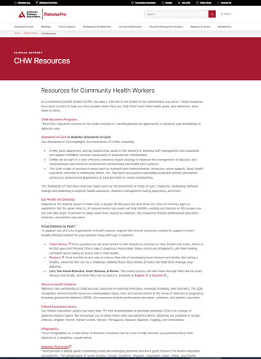
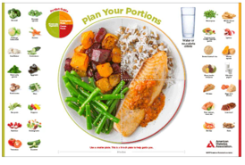
Resources You Can Use From the ADA Website
American Diabetes Association resources for CHWs
https://professional.diabetes.org/clinical-support/chw-resources

Slide 19
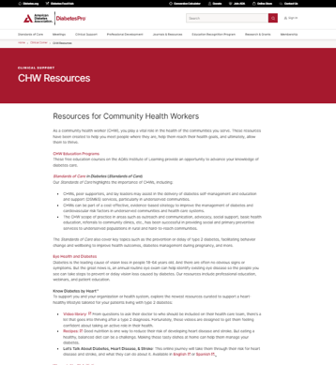
Exercise: Access Resources on ADA website and Report Out (Optional)
Option 1. Navigate there on the presentation and view together
Go to: https://professional.diabetes.org/clinical-support/chw-resources
OR
Option 2: Participants take 5 minutes and look at ADA resources on their phone.
Go to this URL and explore resources on your own
https://professional.diabetes.org/clinical-support/chw-resources
What resource/s did you find?
How might you or your organization use it?

Slide 20
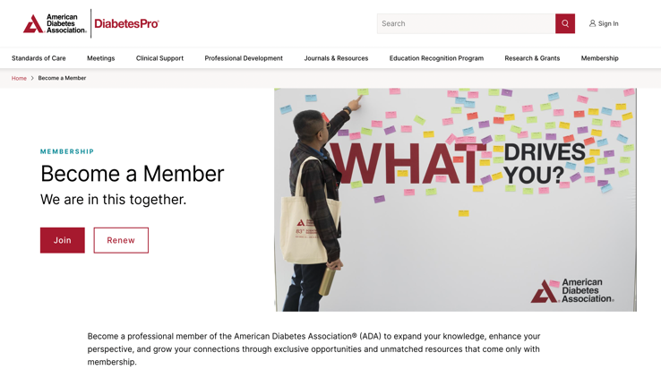
Exercise: Become a Professional Member of the ADA as a CHW (Optional)
Visit https://professional.diabetes.org/membership
Then scroll down and select: “Community Health Workers”

Slide 21
Root cause analysis
with the The 5 Whys
“Laser” presentation
skills
Creating a 5-part QI goal
Gathering stories and numbers (data)
about the quality issue

Slide 22
Reflection: Did We Accomplish the Learning Objectives from Module 3?
Describe people at your organization you might work with on QI
Use laser communication to share your QI ideas with your organization
Describe two resources available from the American Diabetes Association that you are interested in using

Slide 23
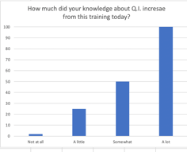
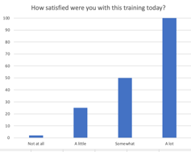
Evaluation
How much did this session increase your knowledge about quality?
B. How satisfied were you with this session today?

Slide 24
Evaluation
C. What was the most helpful part of the session for you today?
D. What is one thing we can change to make this session more helpful next time?

Slide 25
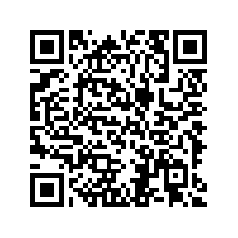
Participant Evaluation
Please use the QR code to open your participant evaluation

