Slide 1
Introduction to Quality Improvement Training for CHWs
Module 2
Prepared by Lyndee Knox and America Bracho

Slide 2
Let’s Review the Learning Objectives From Module 1
Describe ways CHWs can help the practices where they work QI
Use the QI journey map to describe the QI process from start to finish
Identify a quality issue and create an improvement goal
Create a process map to use in QI work

Slide 3
CHWs are Powerful QI Partners!
They can share stories they hear from patients
They can share their own lived experiences
They can share their expertise and knowledge of the community

Slide 4
Review Learning Objective 2
Describe ways CHWs can help the practices where they work with QI
Use the QI journey map to describe the QI process from start to finish
Identify a quality issue and create an improvement goal
Create a process map to use in QI work

Slide 7
Review Learning Objective 3
Describe ways CHWs can help the practices where they work with QI
Use the QI journey map to describe the QI process from start to finish
Identify a quality issue and create an improvement goal
Create a process map to use in QI work

Slide 8
You Used This Set of Questions To Help You Create a QI goal
My/our quality issue is: _______________________________
What do I/we want to accomplish?
How will I/we know when it has been accomplished?
Is it possible to really do this?
4. Why is it important to do?
5. When will I/we finish?

Slide 9
Review Learning Objective 4
Describe ways CHWs can help the practices where they work with QI
Use the QI journey map to describe the QI process from start to finish
Identify a quality issue and create an improvement goal
Create a process map to use in QI work

Slide 10
You Learned to Create a Process Map
Drawing out the steps of a process can help you figure out where problems is and how to fix it.
You learned to create maps that look a bit like this
Open gas tank
Insert hose
Push in trigger and hold
Handle “clicks” and gas turns off when full
Remove hose and return to pump

Slide 11
You Have Two Tools in Your QI Backpack from Module 1
Creating a
process
map
Creating a
QI Question

Slide 12
You Will Learn 2 More Tools Today in Module 2
Creating a
process
map
Creating a
QI Question
Using
the 5 Whys
to find root causes
Brainstorming

Slide 13
At the End of Module 2, You Will Be Able To:
Use the 5 Whys to analyze the root cause of a personal quality issue
Hold a brainstorming session to generate possible solutions
Describe steps one through six of the QI process

Slide 14
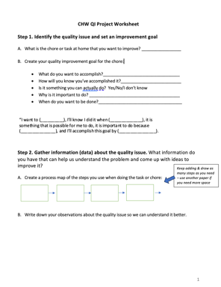
First, Let’s Review Your Homework! Who Will Volunteer?

Slide 15
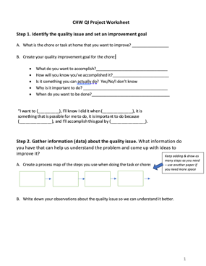
Homework: Your Personal QI Project
What was the quality issue you wanted to fix?
What was your QI goal? (Read the questions and your answers to each)
What Do You Want to Accomplish?
How Will You Know When it Has Been Accomplished?
Is It Possible to Really Do?
Why Does It Matter?
When Will You Finish?
Talk us through the process map you created

Slide 16
Your personal QI project: Let’s open it up to the group now
What was the most important thing you learned from doing this homework?
What was your biggest challenge doing this homework?
What questions do you have after doing it?
We’ll create a “parking lot” of questions to answer/address later

Slide 18
What is a ROOT CAUSE?
Every quality problem has “roots” just like a tree.
We need to identify the root or roots of the quality issue to be able to fix it.

Slide 19
Quality Issues are Like Weeds!
When you only pull the top of the weed out, it will grow back!
Quality problems are the same.
Unless you identify the root of the problem the problem will return.

Slide 20
What is the problem?
_______________________
The 5 Whys
Rules:
1) Be as specific and real/factual as possible with your answer to the first “Why?”
2) Know when to stop. Keep asking “Why?” until the responses aren’t useful and you can’t go any further.
3) If there is more than one reason for the problem, do the 5 Whys for each reason.
4) The root cause cannot be a person or personality or something you can’t change. It must be a process or something you are able to change.
5) Don't stop at number 5 if you haven't found your root cause yet. Ask, "Why?" as many times as you need to.
Why?
Why?
Why?
Why?
Why?

Slide 21
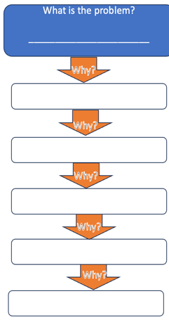
The 5 Whys: The Flat Tire
The Problem: Janice got a flat tire on the way to work. This happens
fairly often and it is creating problems for her at work.
She decides to use the 5 Whys to find the root cause of her flats.
I got a flat tire
There was a nail in my tire
There are nails on my garage floor
The box holding the nails broke & nails spilled on floor
If Janice had stopped asking “Why?” after she discovered that there were nails on the garage floor – the place many people would stop - she would have MISSED the root cause of the problem and it would have happened again.
The box got wet & the cardboard collapsed
The root cause
There is a leak in the garage roof
Source: https://www.cms.gov/medicare/provider-enrollment-and-certification/qapi/downloads/fivewhys.pdf

Slide 22
The 5 Whys: The Flat Tire
I got a flat tire
There was a nail in my tire
There are nails on my garage floor
The box holding the nails broke & nails spilled on floor
Janice could have kept going and asked more "whys" but she used the rules to know when to stop
Rule # 4: The root cause cannot be a person or personality or something unchangeable. It must be a process or something you are able to change.
Rain isn’t something she can change. So she stopped at the fifth "Why?" The root cause for her problem was the leak.
The box got wet & the cardboard collapsed
The root cause
There is a leak in the garage roof
It rained last night

Slide 23
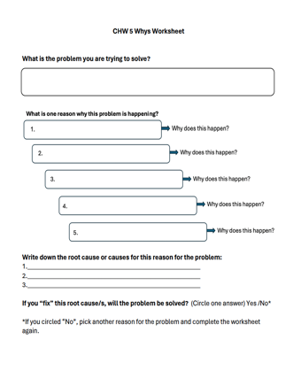
CHW 5 Whys Worksheet
Rules:
1) Be as specific and real/factual as possible with your answer to the first “Why?”
2) Know when to stop. Keep asking “Why?” until the responses aren’t useful and you can’t go any further.
3) If there is more than one reason for the problem, do the 5 Whys for each reason.
4) The root cause cannot be a person or personality or something you can’t change. It must be a process or something you are able to change.
5) Don't stop at number 5 if you haven't found your root cause yet. Ask, "Why?" as many times as you need to.

Slide 25
Step 4. Generate ideas of changes to try
Discuss with peers and Brainstorm
We can do this informally at meetings, during breaks, or use a structured process like brainstorming.
You’ll learn more about brainstorming in a minute.

Slide 26
Step 4. Generate ideas of changes to try
Get Ideas from an Exemplar!
Exemplars are people we can learn from because they have already solved the same problem we are working on.
We can learn from them and copy what they do.
How to find an exemplar? Just ask!
“Who do you know in our organization/practice/community that is already doing this really well?”
“Who do you know in our organization/practice/community that has already solved this problem?”

Slide 27
Step 4. Generate ideas of changes to try
Read Research and Reports
Read research and reports on the issue you are trying to fix or improve and get ideas from them.
You can find these by:
Searching the internet
Asking someone doing research
Asking an organizational partner like a university
Be sure to check the source of the reports
Are they sincere and trying to share well gathered knowledge?
Or are they writing the report for other purposes like selling something?

Slide 28
Step 4. Generate ideas for changes to test
Get Ideas from CHWs!
Share your own ideas with your organization or practice.
CHWs have:
A deep understanding of the patients and their experiences with health and your organization
Their own experience
A deep understanding of the community’s needs, strengths and preferences
Can come up with great and creative solutions no one else would think of!

Slide 29
CHW Nancy’s Idea to Increase the Number of Patients with Diabetes Who Get Annual Eye Exams
Only 1 out of 10 of their patients with diabetes is getting their annual eye exam.
Clinicians and staff at the practice, including Nancy, are very worried about this.
1:10

Slide 30
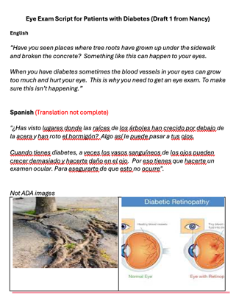
CHW Nancy’s script to increase number of patients getting eye exams*
CHW Nancy knows the reason patients are not getting exams is because they say they “see just fine.”
She tells suggests to her medical director that clinicians tell patients a story that will help them understand why it is important.
She writes a script with pictures of the story she suggests and gives it to her medical director.
*Idea and script created by the Promotores from Latino Health Access in Santa Ana CA.

Slide 31
An Introduction to Brainstorming
Brainstorming is fun and simple.
You can brainstorm by yourself, with one other person, or with a group.
Rules for a Formal Brainstorming Session
No criticism or correction of any idea- THIS IS THE MOST IMPORTANT RULE!
Come up with as many ideas as possible. Quantity over quality.
Build on and add to each other’s ideas. “We can do that AND…..”
Encourage wild ideas. Be creative!

Slide 32
Steps for holding a Brainstorming Session!
Identify the facilitator for the session (you?)
Set aside 30 minutes to an hour.
Write the rules for brainstorming on the board and teach them to the group. Remind the group of rules if they break them.
Write people’s ideas down on board/paper using exactly the same words they use. Do not edit or change what they say.
After the session is over, schedule a follow-up meeting to review each of the ideas with the group and select ones to test. NEVER DO THIS DURING THE ACTUAL BRAINSTORMING SESSION

Slide 33
Rules for Successful Brainstorming
No criticism or correction of any idea.THIS IS THE MOST IMPORTANT RULE.
Come up with as many ideas as possible. Quantity over quality.
Build on and add to each other’s ideas. “We can do that AND…..”
Encourage wild ideas. Be creative!

Slide 35
Select the Best Idea to Test
Make a list of all the ideas being considered.
Evaluate each one using questions like these:
Will this change address the root cause?
Is this change feasible (cost, time, effort, training)?
Will it negatively impact staff morale?
Will it negatively impact patient experience?
Will it negatively impact quality of care?
Discuss and decide on the first one to test.
Have doctors use Nancy’s Sidewalk script

Slide 36
Test the Idea to See if it Works: Small Tests
To test our idea we start SMALL.
We use “small” tests of change.
We test with only ONE OR TWO staff members, patients, doctors or customers.
Study it
Make adjustments
Test again
Until we are SURE it works.
Or decide to try another idea on our list.

Slide 37
PDSAs
Plan
QI VOCABULARY
In primary care practices, these small tests of a change Plan Do Study Act Cycles or PDSAs.
Study
Act
PDSA
Do

Slide 38
The Team Does a Fist Small Test: Dr. Hernandez with Three of His Patients
Dr. Hernandez uses the sidewalk story with three of his patients.
He and the team studied what happened.
Patients:
Like the story.
Understand why eye exams are important
Plan to schedule an eye exam
Dr. Hernandez:
Learned it takes too much time during the patient visit

Slide 39
The Team Does a Second Small Test: CHW Nancy and Five of Her Patients
Based on this learning, the team makes adjustments to the change.
They decide to have CHWs share the sidewalk story when they meet with patients.
Nancy uses it with five of her patients.
The team studies it and learns it is:
Found it easy for Nancy to fit into her visits
Patients want a list of places to get an eye exam

Slide 40
The team does a 3rd SMALL test: 3 CHWs with 20 patients
CHW Nancy:
Found it easy to fit into her visit with the patients
Patients would like a list of places to go to for an eye exam
The team runs a third small test:
All three CHWs at the practice tell the story to their next 20 patients
Include a referral list for eye exams to give patients

Slide 42
Implement the Solution
Implementing the new solution means getting everyone in the organization to start doing something new.
There are several things you can use to help people implement a new process or solution. You can use:
Training & job aids
Reminders
Feedback on people’s performance

Slide 43
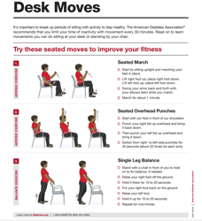
Training & Job Aids
Training can be done in groups or one-on-one or by video.
Job aids are step-by-step instruction sheets that show a person how to do the new process. They might include:
Pictures
Process maps (like the ones you learned about in Module 1)
Short descriptions

Slide 44
Reminders
Sidewalk Story
Every patients w/ T2D
Reminders help people remember to do the “new thing.”
Reminders can be:
Posters on the wall,
Stickies on a desk
Alerts that pop-up on a computer or EHR systems
HELP YOUR PATIENTS’ SAVE THEIR EYESIGHT!
Sidewalk Story =
Every patient w/ T2D

Slide 45
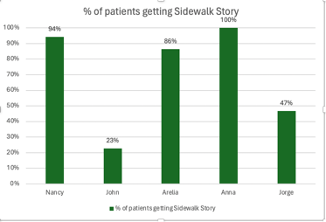
Feedback
How often is each person using the new solution vs. the old way of doing things?

Slide 46
Implementing the Sidewalk Story at Happy Family Clinic
To implement the sidewalk story at Happy Family Practice, the practice manager:
Scheduled a one-hour training for CHWs
Provided a Job Aid with the script in English & Spanish

Slide 47
Implementing the Sidewalk Story at Happy Family Clinic
AND Finally…
DON’T forget to CELEBRATE Wins!
Appreciating people for their hard work & celebrating wins also helps people implement new solutions!
The medical director at Happy Family Practice:
held a pizza party for the CHWs when ALL patients seen in a week heard the sidewalk story!

Slide 48
The 4 Tools in Your Toolbox!
Creating a
process
Map
Module 1
Creating a
QI Question
Module 1
Using
the 5 Whys
to find root causes
Module 2
Brainstorming
Module 2

Slide 49
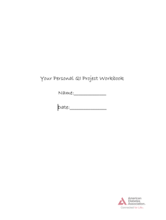
Homework:
Finish Your Personal QI Project Workbook!

Slide 50
At the end of Module 2, you will be able to:
Use the 5 Whys to analyze the root cause of a personal quality issue
Hold a brainstorming session to generate possible solutions
Describe steps one through six of the QI process

Slide 51
At the end of Module 2, you will be able to:
Use the 5 Whys to analyze the root cause of a personal quality issue
Hold a brainstorming session to generate possible solutions
Describe steps one through six of the QI process

Slide 52
What is the problem?
_______________________
The 5 Whys
Rules:
1) Be as specific and real/factual as possible with your answer to the first “Why?”
2) Know when to stop. Keep asking “Why” until the responses aren’t useful and you can’t go any further.
3) If there is more than one “reason” for the problem – do the 5 Whys for each “reason.”
4) The “root cause” cannot be a person or personality or something you can’t change. It must be a process or something you are able to change.
5)The number “5” isn’t magic, ask the question Why as many times as you need to.
Why?
Why?
Why?
Why?
Why?

Slide 53
At the end of Module 2, you will be able to:
Use the 5 Whys to analyze the root cause of a personal quality issue
Hold a brainstorming session to generate possible solutions
Describe steps one through six of the QI process

Slide 54
An Introduction to Brainstorming
Brainstorming is fun and simple to do.
You can do brainstorming alone, with one other person or with a group.
Rules for a Formal Brainstorming Session
No criticism or correction of any idea. Ever! THIS IS THE MOST IMPORTANT RULE.
Come up with as many ideas as possible. Quantity over quality.
Build on and add to each other’s ideas. “We can do that AND…..”
Encourage wild ideas. Be creative!

Slide 55
At the end of Module 2, you will be able to:
Use the 5 Whys to analyze the root cause of a personal quality issue
Hold a brainstorming session to generate possible solutions
Describe steps one through six of the QI process

Slide 57
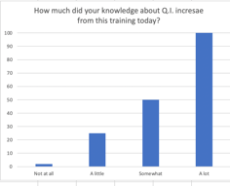
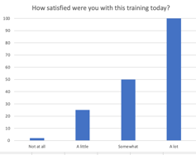
Evaluation
How much did this session increase your knowledge about quality?
B. How satisfied were you with this session today?

Slide 58
Evaluation
C. What was the most helpful part of the session for you today?
D. What is one thing we can change to make this session more helpful next time?

Slide 59
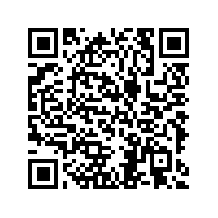
Participant Evaluation
Please use the QR code to open your participant evaluation

