Slide 1
Introducing CHWs to QI
Using the QI 101 for CHWs Training Modules

Slide 2
Learning Objectives: At the End of this Module, you will be able to
Design a training for CHWs using the ADA’s QI 101 Modules for CHWs
Describe three techniques for increasing practice readiness to engage CHWs in QI
List two ways of being an effective partner with CHWs on QI

Slide 3
Who Are Community Health Workers?
A community health worker is a frontline public health worker who is a trusted member of and/or has an unusually close understanding of the community served.
American Public Health Association (2009)

Slide 4
CHWs' Role in Healthcare
Health education and promotion
Care coordination and navigation
Chronic disease management support
Social determinants of health (SDOH) identification & service navigation
Peer support and advocacy
Empowerment and motivation
Building trust
Skill-building to promote self-efficacy in diabetes self-management
Increase provider knowledge about a patient
Facilitate linkage to social services and community resources
Source: https://www.ncbi.nlm.nih.gov/pmc/articles/PMC8622376/

Slide 5
Why Involve CHWs in QI?
CHWs' firsthand observations and interactions with patients allow them to identify critical quality issues that traditional QI data may not capture.

Slide 6
The ADA’s QI Training Modules for CHWs
Created to equip CHWs to participate in QI in a meaningful way in their organizations and in the primary care practices where they work.

Slide 7
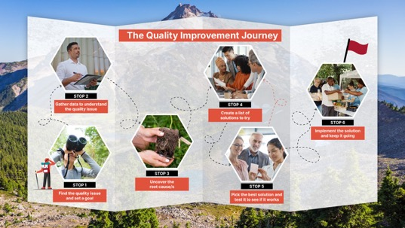

Slide 8
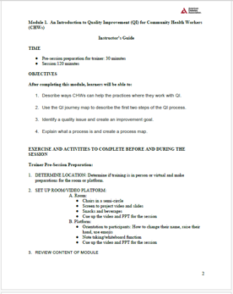
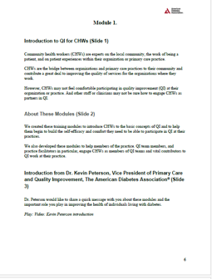
Structure of the Modules
An instructor’s guide
A PDF narrative as script or notes
Powerpoint slides

Slide 9
Delivery of the Modules
Each module takes 120 minutes to complete, plus homework post-session
They can be broken into “mini-modules” to fit into shorter time periods
They are designed to be delivered sequentially
They can be delivered in-person or through a video conferencing platform

Slide 10
Module 1: Introduction to the QI Journey: Creating a QI Goal and Process Mapping
Content
What is Quality?
CHWs as QI partners
What is Quality Improvement?
The Six Stop QI journey
Stop 1 on the Journey: Identify the Quality Issue and Create a QI Goal
Stop 2 on the Journey: Gather Data to Understand the Quality Issue
Skill Building: Learn To Process Map
Reflection and Evaluation
Job Aids and Worksheets
QI Goal Creation Worksheet
Process Mapping Worksheet
Homework: Personal QI Project Page 1

Slide 11
Module 2: Introduction to the QI Journey: The 5 Whys and Brainstorming
Content
Exercise: Present Your Homework
Job Aids & Worksheets
Job Aid: The 5 Whys
Stop 3 on the Journey: Find the Root Cause of the QI Issue
Skill Building: The 5 Whys
Stop 4 on the Journey: Generate Solutions to Test
Skill Building: Brainstorming
Stop 5 on the Journey: Select the Best Idea and do Small Tests
Stop 6: Implement What Works and Keep it Going
Reflection and Evaluation
Job Aid: Brainstorming
Homework: Person QI Project page 2

Slide 12
Module 3: Introduction to the QI Journey: The 5 Whys and Brainstorming
Content
Job Aids and Worksheets
Laser Presentation Worksheet
Present your Homework
Who Can You Work with on QI in your Organization?
How People Talk About QI in Busy Organizations
The American Diabetes Association (ADA)
Resources for CHWs on the ADA Website
Reflection & Evaluation
Who I Will Partner with at My Organization on QI worksheet

Slide 13
Goal: Build QI Self-Efficacy
Self-efficacy is not just the acquisition of simple knowledge and skills, but a belief in their ability to accomplish tasks (Bandura, 1997).
A learner develops mastery through:
Repeated success completing tasks
Overcoming challenges
Learning from role models
Reflecting on learning & performance, and performing the task again

Slide 14
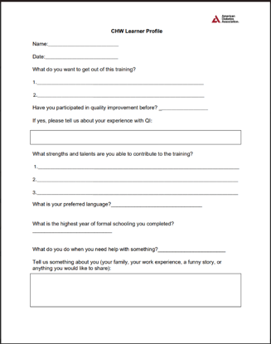
Know Your Learner
Well-designed training for CHWs considers their status as:
adult learners
literacy levels
preferred language
cultural preferences, and the
expertise they have developed through their life experiences
Be familiar with traditional CHW training

Slide 15
Know Your Learner
Be familiar with traditional CHW training
Communication skills
Interpersonal and relationship-building skills
Service coordination and navigation skills
Capacity building skills
Advocacy skills
Education and facilitation skills
Individual and community assessment skills
Outreach skills
Professional skills and conduct
Evaluation and research skills
Knowledge base of public health principles and social determinants of health

Slide 16
Know Your Learner
Gather Learner Profiles from your CHW participants

Slide 17
Incorporate Principles of Adult Education and Diverse Learners into Your Training
Provide accessible materials and content
Be flexible
Be a co-learner rather than a teacher
Acknowledge the CHWs’ expertise and build on it
Facilitate critical inquiry
Keep it simple, clear, and sequential
Be practical & interactive
Repeat, repeat, repeat
Incorporate opportunities for feedback, reflection and action
Celebrate!

Slide 18
Engage CHWs in QI
Work with practice and QI leadership to remove barriers to CHW participation in QI
Model inclusion of CHWs in QI for the practice
Educate practice members on the value CHWs can bring to QI
Provide concrete examples of contributions CHWs have made to QI

Slide 19
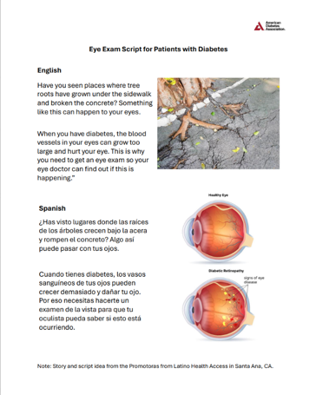
Build PCP Buy-in for CHWs Inclusion in QI Work by Sharing Success Stories
One example of a success story is the script that CHWs developed to educate patients with diabetes about why they should get regular eye exams even if they think they don’t need one.
The CHWs took an everyday experience that their patients were familiar with -- a sidewalk broken by tree roots- and used this to explain what can happen in a person’s eye who has diabetes.
In one PCPs office, the number of patients going for eye exams after health education sessions went from 20% to over 95% after CHWs shared this with patients.

Slide 20
Be an Effective QI Partner to CHWs
Shadow CHWs in the field
Solicit CHWs’ input on current QI projects
Be a QI co-pilot
Help CHWs continue to develop their QI skills
Support CHWs' Dual Role

Slide 21
Reflection: After Completing This Module, Are You Able To:
Design a training for CHWs using the American Diabetes Association’s QI 101 Modules for CHWs
Describe three techniques for increasing practice readiness to engage CHWs in QI
List two ways of being an effective partner with CHWs on QI

Slide 22
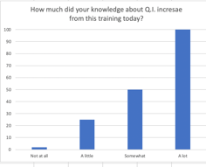
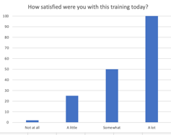
Evaluation
How much did this session increase your knowledge about quality?
B. How satisfied were you with this session today?

Slide 23
Evaluation
C. What was the most helpful part of the session for you today?
D. What is one thing we can change to make this session more helpful next time?

Slide 24
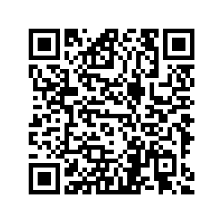
Participant Evaluation
Please use the QR code to open your participant evaluation

