Slide 1
Introduction to Quality Improvement Training for CHWs
Module 1
Prepared by Lyndee Knox and America Bracho

Slide 2
About These Introductory Modules
Developed to train CHWs in QI skills
To use:
In their own work with patients
With their organizations
In primary care practices

Slide 3
Welcome!
Kevin Peterson, MD, Vice President of Primary Care and Quality Improvement
American Diabetes Association®

Slide 4
About These Introductory Modules
Module 1
The Six Stops on the QI journey
Stop 1. Identifying a quality issue & creating a quality goal
Stop 2. Gathering data using process mapping
Module 2
Stop 3. Finding the “root” cause of a quality issue with “5 Whys”
Stop 4. Generating improvement ideas to try
Stop 5. Picking the best idea and testing it
Stop 6. Implementing the improvement & keeping it going
Module 3
Who you will work with on QI
Creating a “laser” presentation
What is good care for Type 2 Diabetes
Resources at the American Diabetes Association and Know Diabetes by Heart

Slide 5
Learning Objectives For Module 1 At the end of this module, you will be able to:
Describe ways CHWs can help the practices where they work with QI
Use the QI journey map to describe the QI process from start to finish
Identify a quality issue and create an improvement goal
Create a process map to use in QI work

Slide 6
What Is Quality?
Good Quality Shoes
Maria says she has a pair of shoes that are “good quality.”
What does Maria mean when she says this?
Poor Quality Shoes
Maria has another pair of shoes and says these shoes are “poor quality.”
What does Maria mean when she says this?

Slide 7
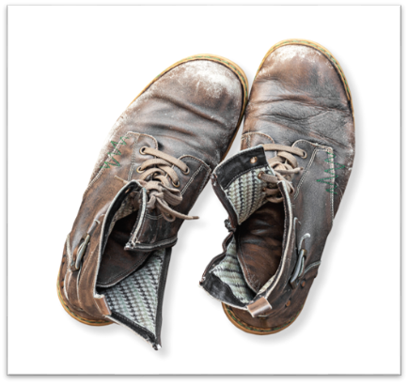
Quality Can Be Mixed
Things can also be a mix of good and poor quality.
Some things work well, and some others don’t.
Even though Maria thinks the shoes are overall poor quality, she says she does like the soles because they are really strong and flexible.
Maria’s shoes have ”mixed quality.”

Slide 8
Good & Poor Quality In Organizations
Where do you work?
A CBO?
A school?
A primary care practice?
What does ”good quality” look like in an organization, like the one you work for?
What does “poor quality” look like?

Slide 9
CHWs Working in Primary Care Clinics
How many of you work, at least some of the time, in a primary care practice?
CHWs are an important part of the primary health care team!
And are being used more and more to provide support and education to patients

Slide 10
CHWs Are Powerful QI Partners Or The Primary Care Practices Where They Work
They can share stories they hear from patients that clinicians and staff may not hear
They can share their own lived experiences as a patient managing their health
They can share their expertise and knowledge of the community around the practice

Slide 11
Good & Poor Quality In A Primary Care Clinic
Good Quality Care
Poor Quality Care
John has type 2 diabetes and goes to Clinica Familiar for his health care.
He says he gets “good quality” care there.”
Last year, John moved to a new city and started going to a new clinic to take care of his diabetes.
He says the clinic ”was not good quality.”
What does John mean when he says he gets “good quality” care at his clinic?
What does he mean the clinic
“was not good quality?”

Slide 12
What Is Quality Improvement Or QI?
QI in healthcare or other places means looking at WHAT’S NOT WORKING WELL, figuring out why, and making changes to make it work better.
Quality improvement is ALSO about finding STRENGTHS, about finding out what works best and sharing those successful practices with others.

Slide 13
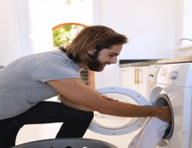
We All Do “Quality Improvement” in Our Daily Lives
Have you ever changed laundry detergent to find one that worked better?
Changed the location of a house plant so it has better light to grow?
Or asked a friend to teach you how they make a certain dish that you like?
What are some examples from your own life last week where you did QI? You making a change to make something better?
Laundry
Cooking
Less phone time

Slide 16
You Can Create a QI Goal By Answering These Questions
What do we want to accomplish?
How will we know when it has been accomplished?
Is it possible?
4. Why is it important to do?
5. When will we finish?
The quality issue is: _____________________________

Slide 17
Creating A QI Goal For A Primary Care Practice
Think about the practice where John said he received “poor quality care.”
SAM the CHW - makes a follow-up call to John after his visit to the clinic.
John - tells him he was not able to meet with the health educator after his visit like his doctor wanted him to and so he is not taking the Insulin his doctor prescribed.
John - explains that he works construction and cannot stop during the day to inject himself.

Slide 18
Creating A QI Goal For A Primary Care Practice: The Power Of CHW Stories
Sam the CHW - shares this with the QI team who realize this is a serious quality issue that they want to fix!

Slide 19
Creating A QI Goal For A Primary Care Practice Using 5 Questions
What is the quality issue: John did not meet with the health educator after his doctor’s visit and so is not taking his medicine
1. What do we want to accomplish? Every patient meets with a health educator after their Diabetes visit
2. How will we know it has been accomplished? When we review our scheduling data and see every patient with a diabetes visit also met with a health educator that week
3. Is it possible to do? Yes
4. Why is it important to do? It will help patients learn how to take their medications
5. When will we do it? By June 30th

Slide 20
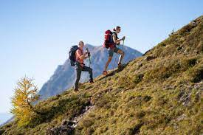
Exercise: Make a QI Goal for Something You Do for Your Organization
Use the CHW QI Goal Sheet handout
My quality issue in my own work is: _________________________
PRO TIP: Be sure to pick an issue that you can control, not something that requires a person to change who they are.
What do I want to accomplish?
How will I know when it has been accomplished?
Is it possible for me (or my family or my organization)?
4. Why is it important to do?
5. When will I finish?

Slide 22
Organizations Use Three Types Of Data In QI
NUMBERS: They count the number of patients in the past 12 months who are satisfied with the services they received.
STORIES: They use stories they hear from patients, staff and clinicians.
PROCESS MAPS: They map the different steps in doing an activity or “process” to identify areas that may be creating a quality issue.

Slide 23
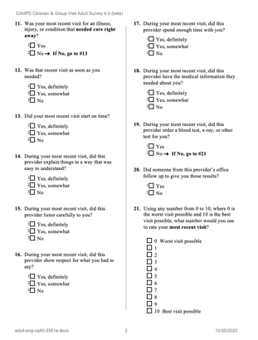
Numbers: Satisfaction Surveys
Practices use satisfaction surveys to get information about patients’ experiences of the practice. A popular one used by a lot of practices is call the CAHPS.
Satisfaction ask questions like:
Did your most recent visit start on time?
Yes, definitely
No
During your most recent visit, did this provider explain things in a way that was easy to understand?
Yes, definitely
No
Practices add up the number of patients who answer Yes and the number of people who answer No to each question and analyze this information to see where there may be problems that need improvement, and also areas where they may be doing really well and are strengths.

Slide 24
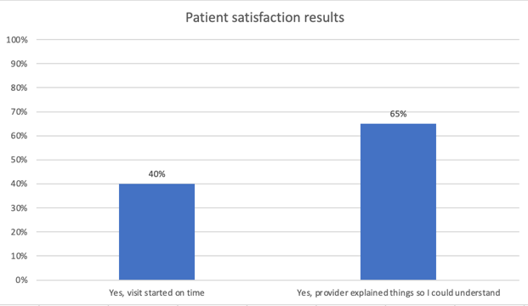
Example Of A QI Report On Patient Satisfaction

Slide 25
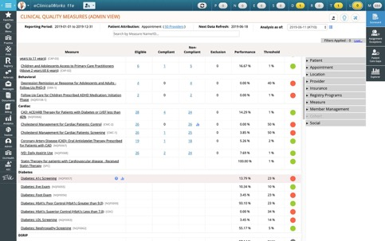
Numbers: HEDIS (for Primary Care Practices)
HEDIS numbers show a practice how well they are doing compared to other practices with
similar patients, and to a national standard or “benchmark.”
Examples of a HEDIS METRIC:
How many patients with type 2 diabetes at the practice measured their HbA1c in the last six months?

Slide 26
Stories
Stories are a very powerful type of Q.I. data. Stories let practices “see” things that they can’t in numbers.
CHW story:
“John didn’t have his health education visit,
and he stopped taking his insulin because he didn’t know
how to manage his medications on his construction job.”

Slide 27
Process Maps
What is a process?
A process is a sequence of steps designed to achieve a specific outcome.
What is a process map?
Drawing out these steps can help us figure out where problems are in a process and fix them.
In QI we call this process mapping or sometimes “workflow mapping.”
They look like this:
Open gas tank
Insert hose
Push in trigger and hold
Handle “clicks” and gas turns off when full
Remove hose and return to pump

Slide 28
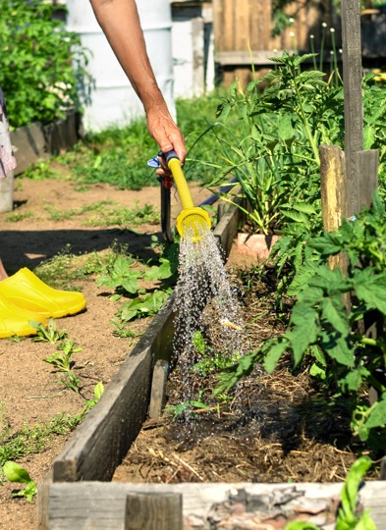
Example of a Process Map: Elodia’s Garden
Elodia has a beautiful vegetable garden in her backyard which she waters twice a week.
Unfortunately, Elodia frequently floods her garden when she waters it. This is causing root rot and her plants are starting to die.
She asks for your help.

Slide 29
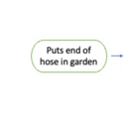
Mapping Elodia’s
Garden Watering Process
You ask Elodia to walk you through the steps she takes in watering her garden.
Because it is easy for her to forget or skip a step, you ask to observe her water her garden.
She says that is not possible, so you ask her questions.
What do you do first? I put the end of the faucet in my vegetable garden.
Let’s create a “map” of Elodia’s process.
What is her first step?
Then the next one? And next?

Slide 30
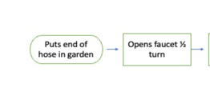
Create A “Map” Of Elodia’s Process
You ask Elodia to walk you through the steps she takes in watering her garden.
Because it is easy for her to forget or skip a step, you ask to observe her water her garden.
She says that is not possible, so you ask her questions.
What do you do first? I put the end of the faucet in my vegetable garden.
Then what do you do? Then I open the faucet about ½ the way open and let the water run.

Slide 31
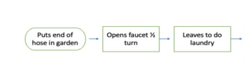
Create A “Map” Of Elodia’s Process
You ask Elodia to walk you through the steps she takes in watering her garden.
Because it is easy for her to forget or skip a step, you ask to observe her water her garden.
She says that is not possible, so you ask her questions.
What do you do first? I put the end of the faucet in my vegetable garden.
Then what do you do? Then I open the faucet about ½ the way open and let the water run.
Then what do you do? While it’s running, I go start my laundry.

Slide 32
Create A “Map” Of Elodia’s Process
You ask Elodia to walk you through the steps she takes in watering her garden.
Because it is easy for her to forget or skip a step, you ask to observe her water her garden.
She says that is not possible, so you ask her questions.
What do you do first? I put the end of the faucet in my vegetable garden.
Then what do you do? Then I open the faucet about ½ the way open and let the water run.
Then what do you do? While it’s running, I go start my laundry.
Then what do you do? After I load the laundry, I come back and check the water.
Let’s create a “map” of Elodia’s process.
What is her first step?
Then the next one? And next?

Slide 33
Create A “Map” of Elodia’s Process
You ask Elodia to walk you through the steps she takes in watering her garden.
Because it is easy for her to forget or skip a step, you ask to observe her water her garden.
She says that is not possible, so you ask her questions.
What do you do first? I put the end of the faucet in my vegetable garden.
Then what do you do? Then I open the faucet about ½ the way open and let the water run.
Then what do you do? While it’s running, I go start my laundry.
Then what do you do? After I load the laundry, I come back and check the water.
Then what do you do? When it’s fully watered, I turn off the faucet.
Let’s create a “map” of Elodia’s process.
What is her first step?
Then the next one? And next?

Slide 34
You can use these maps to study where the problem is.
What part of Elodia’s process might be causing her problem?

Slide 35
Help Elodia Improve Her Process
You can use process maps to discover where the problem is.
What part of Elodia’s process might be contributing to her problem of over-watering?

Slide 36
Exercise: Create A Map Of
“Making A Cell Phone Call” Real-Time
Divide into groups of 3 and assign roles:
Phone user (needs to have a cell phone with them today
Process mapper
Helper
Exercise (7 minutes):
Phone user go through the actual steps of making a phone call
Process mapper, map each of these steps
Helper ask questions to help the Process mapper catch all steps
You will have 5 minutes to do this.
Discussion (5 minutes):
What was interesting to you about this exercise?

Slide 37
Rules for Making Process Maps
If possible, make the map by watching the activity happening in ”real-time” NOT from memory
The person who does the process should be central in making the map

Slide 38
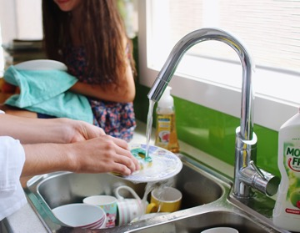
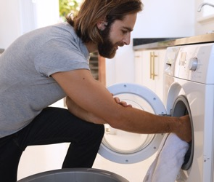
Your Homework: For Next Session
Pick a problem you have with a chore or task at home you’d like to improve:
Dog barks a lot
Dishes always pile up
I forget to water the garden often
The laundry takes too long to do
Other
PRO TIP: Be sure to pick an issue that you can control, not something that requires a person to change who they are.

Slide 39
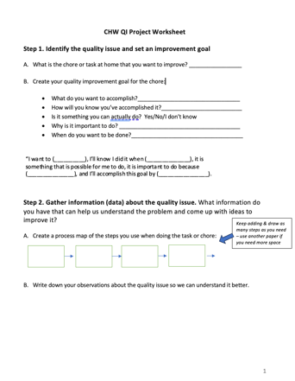
Complete The CHW
QI Project Worksheet About This Quality Issue
State the quality issue
Create your quality improvement goal
Map your process

Slide 40
Reflection: Did We Achieve The Learning Objectives?
Describe ways CHWs can help the practices where they work with QI
Use the QI journey map to describe the QI process from start to finish
Identify a quality issue and create an improvement goal
Create a process map to use in QI work

Slide 41
CHWs Are Powerful QI Partners For The Primary Care Practices Where They Work
They can share stories they hear from patients that clinicians and staff may not hear
They can share their own lived experiences as a patient managing their health
They can share their expertise and knowledge of the community around the practice

Slide 42
Reflection: Did We Achieve The Learning Objectives?
Describe ways CHWs can help the practices where they work with QI
Use the QI journey map to describe the QI process from start to finish
Identify a quality issue and create an improvement goal
Create a process map to use in QI work

Slide 45
Reflection: Did We Achieve The Learning Objectives?
Describe ways CHWs can help the practices where they work with QI
Use the QI journey map to describe the QI process from start to finish
Identify a quality issue and create an improvement goal
Create a process map to use in QI work

Slide 46
You Can Create a QI Goal by Answering These Questions
What do we want to accomplish?
How will we know when it has been accomplished?
Is it possible to really do this?
4. Why is it important to do?
5. When will we finish?
The quality issue is: _____________________________

Slide 47
Reflection: Did We Achieve The Learning Objectives?
Describe ways CHWs can help the practices where they work with quality improvement
Use the QI journey map to describe the quality improvement process from start to finish
Identify a quality issue and create an improvement goal
Create a process map to use in QI work

Slide 48
Evaluation
How much did this session increase your knowledge about quality improvement or QI?
B. How satisfied were you with this session today?
C. What was the most helpful part of the session for you today?
D. What is one thing we can change to make this session more helpful next time?

Slide 49
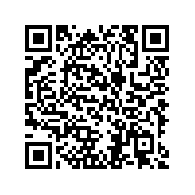
Participant Evaluation
Please use the QR code to open your participant evaluation

